Slide 1
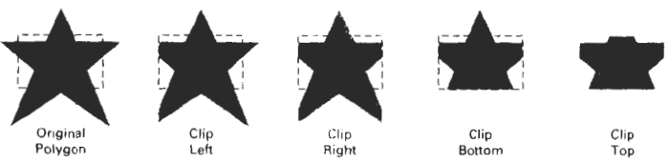
Sutherland-Hodgeman Polygon clipping
Process the polygon boundary as a whole against each window edge
This could be accomplished by processing all polygon vertices against each clip rectangle boundary in turn
Beginning with the initial set of polygon vertices, we could first clip the polygon against the left rectangle boundary to produce a new sequence of vertices.
The new set of vertices could then be successively passed to a right boundary clipper, a bottom boundary clipper, and a top boundary clipper

Slide 2
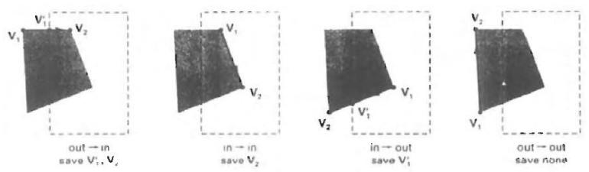
There are four possible cases when processing vertices in sequence around the perimeter of a polygon.
If the first vertex is outside the window boundary and the second vertex is inside, both the intersection point of the polygon edge with the window boundary and the second vertex are added to the output vertex list.

Slide 3
If both input vertices are inside the window boundary, only the second vertex is added to the output vertex list
If the first vertex is inside the window boundary and the second vertex is outside, only the edge intersection with the window boundary is added to the output vertex list.
If both input vertices are outside the window boundary, nothing is added to the output list

Slide 4
Once all vertices have been processed for one clip window boundary, the output list of vertices is clipped against the next window boundary

Slide 5
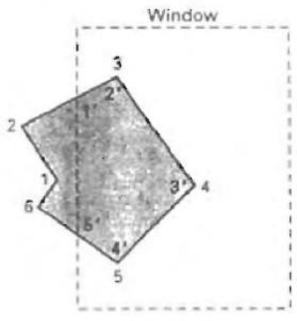
Example
Process the area against left boundary
Vertices 1 and 2 are outside the boundary, so they are not saved
Vertex 3 is inside, so we save the intersection and vertex 3
Vertices 4 and 5 are inside, both are saved
Vertex 5 is inside and vertex 6 is outside, vertex 5 and the intersection are saved
Vertices 6 and 1 are outside, so they are not saved

Slide 6
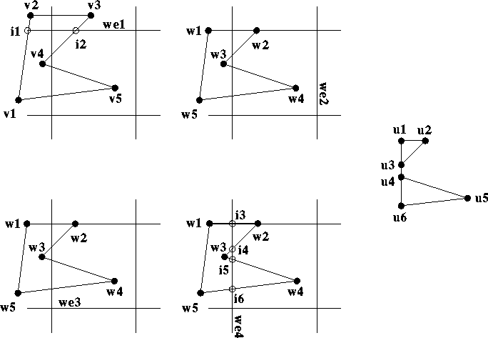
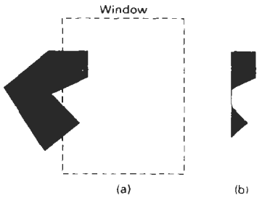
Disadvantages
Convex polygons are correctly clipped by the Sutherland-Hodgeman algorithm
concave polygons may be displayed with unwanted lines
This occurs when the clipped polygon should have two or more separate sections.
Because there is only one output vertex list, the last vertex in the list is always joined to the first vertex
Other algorithms can be used to solve this problem

